Slide 1
Correlation and Regression
Correlation is a statistical technique used to describe the strength of a linear (straight line) relationship between two variables
Regression tells us how to draw the straight line described by the correlation
Uses a variable (x) to predict some outcome variable (y)
Tells you how values in y change as a function of changes in values of x

Slide 2
Difference between Correlation and Regression
Correlation Coefficient, R, measures the strength of bivariate association
The regression line is a prediction equation that estimates the values of y for any given x

Slide 3
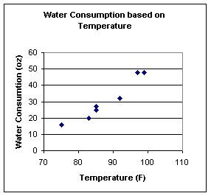
How would you describe the graph?
Notes:
This graph helps us visualize what appears to be a somewhat linear relationship between temperature and the amount of water one drinks.

Slide 4
How “strong” is the linear relationship?

Slide 5
Measuring the Relationship
Pearson’s Sample Correlation Coefficient, r
  R is a measure of strength of the linear association between two variables, x and y.
  It measures the direction and the strength of the linear association between two numerical paired variables.

Slide 6
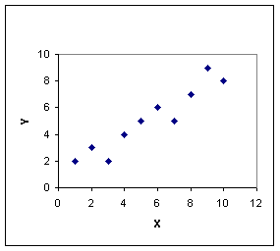
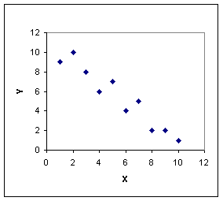
Direction of Association
Positive Correlation
Negative Correlation
Notes:
Direction of the Association: The association can be either positive or negative. Positive Correlation: as the x variable increases so does the y variable. Example: In the summer, as the temperature increases, so does thirst. Negative Correlation: as the x variable increases, the y variable decreases. Example: As the price of an item increases, the number of items sold decreases.

Slide 7
Strength of Linear Association
r value
Interpretation
1
perfect positive linear relationship
0
no linear relationship
-1
perfect negative linear relationship
Notes:
Strength of the Association: The strength of the linear association is measured by the sample Correlation Coefficient, r. r can be any value from –1 to +1. The closer r is to one (in magnitude) the stronger the linear association. If r equals zero, then there is no linear association between the two variables.

Slide 8
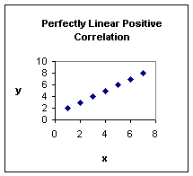
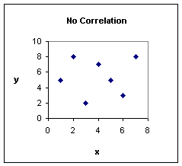
Strength of Linear Association

Slide 9
Strengths of Association
r value
Interpretation
0.9
strong association
0.5
moderate association
0.25
weak association
Notes:
* No other values of r have precise definitions of strength. See the chart below.
Note: All of the values in the second table are positive. Thus the associations are positive. The same strength interpretations hold for negative values of r, only the direction interpretations of the association would change.

Slide 10
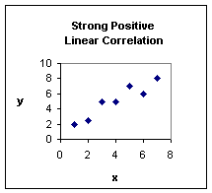
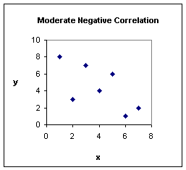
Strengths of Association

Slide 11
Limitations of the correlation coefficient
Though R measures how closely the two variables approximate a straight line, it does not validly measures the strength of nonlinear relationship
When the sample size, n, is small we also have to be careful with the reliability of the correlation
Outliers could have a marked effect on R
Causal Linear Relationship

Slide 12
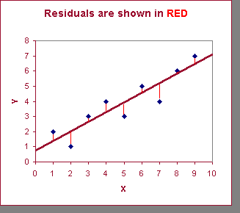
Least Squares Regression
Calculates the “best-fit” line for a certain set of data
The regression line makes the sum of the squares of the residuals smaller than for any other line
Regression minimizes residuals
GOAL - minimize the sum of the squared differences between the points (observed values) and the line (predicted values) .

Slide 13
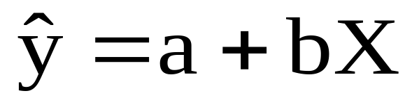
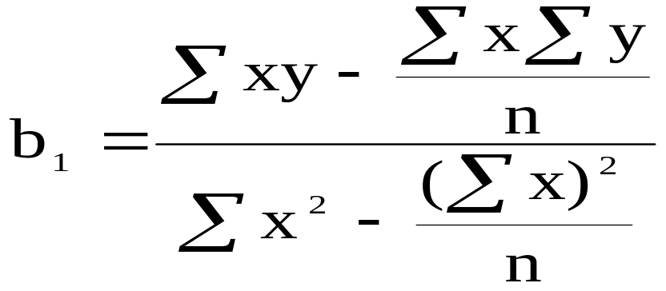
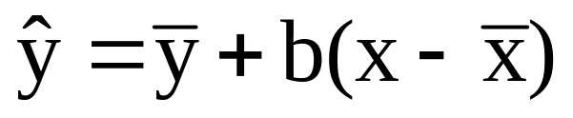
By using the least squares method (a procedure that minimizes the vertical deviations of plotted points surrounding a straight line) we are able to construct a best fitting straight line to the scatter diagram points and then formulate a regression equation in the form of:
b

Slide 14
The Least Squares (Regression) Line
Sum of squared differences =
(2 - 1)² +
(4 - 2)² +
(1.5 - 3)² +
(3.2 - 4)² = 6.89
Sum of squared differences =
(2 -2.5)² +
(4 - 2.5)² +
(1.5 - 2.5)² +
(3.2 - 2.5)² = 3.99
Let us compare two lines
4
(2,4)
⬥
The second line is horizontal
(4,3.2)
3
⬥
2.5
2
⬥
(1,2)
(3,1.5)
⬥
The smaller the sum of
squared differences
the better the fit of the
line to the data.
1
1
2
3
4

Slide 15
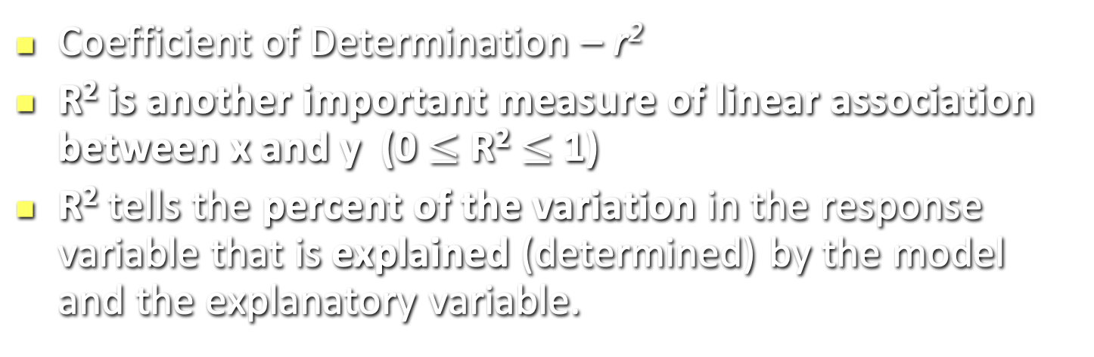
Strength of the Association: r²
Example: r² =92.7%.
Interpretation:
  Almost 93% of the variability in the amount of water consumed is explained by outside temperature using this model.
  Note: Therefore 7% of the variation in the amount of water consumed is not explained by this model using temperature.

